Slide 1
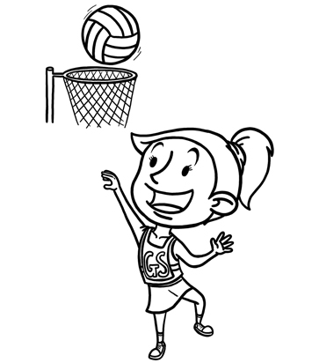
Competition Update
For Season 2022

Slide 2
Berkeley Court Refurbishment
The season will commence as previously advised on Saturday 30 April
The persistent wet weather has resulted in further delays in the completion of the refurbishment of the courts
The latest information is that the courts will be laid and temporarily marked for us to play on Saturday 4 June

Slide 3
Fairy Meadow Courts
After discussions with the clubs who frequent Fairy Meadow courts there is significant concern that the grass courts may not be suitable for the beginning of the season, so other than one 8 year old game, games have been allocated to hard courts at both Fairy Meadow (NSG and Juniors only) and Berkeley
If the grass courts (with small rings) are appropriate for the 8 years teams, they can be moved on the day

Slide 4
Game Dates – including July school holidays
In order to allow a full competition with the limited courts we have while the refurbishment is completed, we need to facilitate games across 16 weeks prior to Finals Series. Games will be played:
Week 1 - 30/04/2022 | Week 8 - 25/06/2022 | Week 15 - 20/08/2022
Week 2 - 07/05/2022 | No Game - 02/07/2022 | Week 16 - 27/08/2022
Week 3 - 14/05/2022 | Week 9 - 09/07/2022 | Semi Finals - 03/09/2022
Week 4 - 21/05/2022 | Week 10 - 16/07/2022 | Finals - 10/09/2022
Week 5 - 28/05/2022 | Week 11 - 23/07/2022 | Grand Final - 17/09/2022
Week 6 - 04/06/2022 | Week 12 - 30/07/2022 | Wet Weather Contingency - 24/09/2022
No Game - 11/06/2022 | Week 13 - 06/08/2022
Week 7 - 18/06/2022 | Week 14 - 13/08/2022
NOTE: this included games on the middle and last weekend of the July school holidays which is different to “normal” practice for our competition. While some families may be away during this time, we hope that the extension of the borrowing rules may enable teams to still play.

Slide 5
Grades with BYES & Senior Duty
There are two grades with odd numbers of teams requiring “BYES” – 11C and Snr B2
The Snr B2 team with a bye will be required to sign on and undertake Canteen duty on their bye week
All other senior teams in the other grades will be required to have two (2) players sign on for umpiring duty on the opposite timeslot each week.

Slide 6
Grades with ‘NO Game’ Weeks
There will be weeks when different grades will have a “NO GAME” week so it will be extremely important that players read the draw carefully to ensure that they are looking at the correct date
This is to facilitate the smaller number of courts that we have available to us until the courts are complete
On the image on the next slide, we are only able to use courts 17, 18, 19, 20, 21, 22, 23, 24, 27, 28, 31, 32, 34 as well as the 6 hard courts at Fairy Meadow.
For example, there are no games for 11B, 12C, 9W, INT A1, INT A2, CAD B1, CAD B2, PL on 30 April
Based on the current arrangements, on 6 August, teams in INT A2 and CAD B1 will be required to play a “double header” - more information will be made available to clubs prior to this date

Slide 7
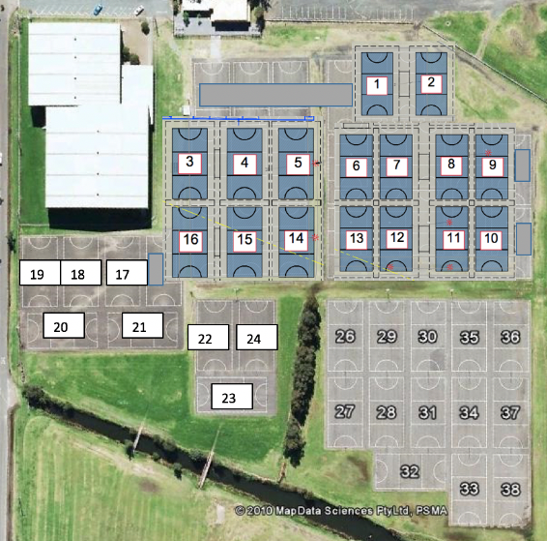
Berkeley – Court Numbering

Slide 8
Further Adjustments May Occur
We are aware that the courts may be further delayed and if this is the case additional amendments may need to be made including playing Finals Series after the September/October school holidays
The courts for the games from 4 June onwards have not yet been allocated as we wait for confirmation from Wollongong City Council of the completion date

Slide 9
Lights & PA System
The poles that will facilitate the new lights and PA system are currently delayed in their delivery due to a mandatory shutdown in China due to COVID outbreaks
Until these are complete, all games will be time your own and temporary lighting will be available on a limited number of courts
These are set to timers and currently light the courts behind the stadium on Tuesday, Wednesday and Friday from 5pm to 8.30pm
If there are additional days required it is not a quick change, so we need to be notified a week in advance to arrange for changes to be made.

Slide 10
Illawarra Teams in Competition
This year the following teams are entered into the subsequent competitions:
15s Representative team is entered into Senior A1
14s Representative team is entered into Senior A1
13s Representative team is entered into Cadet A1
12s Representative team is entered into Intermediate A1
These teams are all included in the competition, they will be a part of the ladder as any other team in the competition and qualify for finals series if they finish in top 4.
For the first time in 2022, there are two 11s Development teams entered into the 12A competition
This is for 2022 only
Not a precedent for future years where the decision would be based on the circumstances at the time
These teams will be filled on a roster from the 30 players selected in the 11s Talent Squad
These teams will not be eligible for Finals Series.

Slide 11
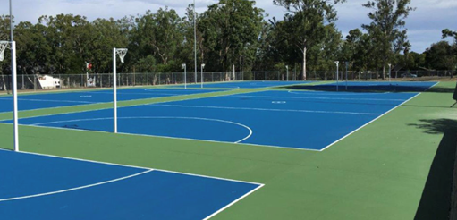
Courts on Completion
Once the season has been completed the courts will be finished with the Rebound Ace top finished similar to the image below

Slide 12
Game Times & Duration
8am - all 8 years, all 11 years and 10B/10C competitions
9.15am - all 9 years, all 12 years and 10A competition
11.00am - all Intermediate competitions
12.10pm - all Cadet Competitions
1.45pm - half of the Senior competitions
3.20pm - half of the Senior competitions
8 and 9 years play 4 x 10 minute quarters
10, 11, 12 years and Intermediates play 4 x 12 minute quarters
Cadets and Seniors play 4 x 15 minute quarters
Breaks for NSG, Jnr, Int are 2 minutes / 3 minutes / 2 minutes
Breaks for Cadet and Senior are 2 minutes / 4 minutes / 2 minutes

Slide 13
Umpire Format and Payments
8 years - umpired by coaches of teams
9-12 years - umpiring roster allocated by Umpiring Committee and club convenors
Int and Cad - umpire your own format
Snr - badged and duty umpires roster allocated by Umpiring Committee
NSG - $10 per team
Juniors - $15 per team
Intermediates - $20 per team
Cadets and Seniors - $25 per team

Slide 14
Borrowing Rules
Teams may borrow up to four (4) players per game
Players can be borrowed from a limited number of grades – see table on next slide
Players cannot be borrowed from teams in their own grade unless prior approval is sought for and provided by IDNA Committee
Each team must have four (4) of their own players on the court to play:
If the team does not have four (4) of their own players to commence the game, this is an unnotified forfeit (note a team must still have 5 players to commence the game and 5 minutes from the start time for this to take place)
If the team loses a player due to injury before half time, the game is abandoned and treated as a forfeit by the team without 4 players
If the team loses a player due to injury after half time, the game is abandoned and the score is counted as the official score of the game.
Players can be borrowed three (3) times and remain registered in their original team. On the 4th time that a player is borrowed, the club must nominate which of the teams the player is then moved to.

Slide 15
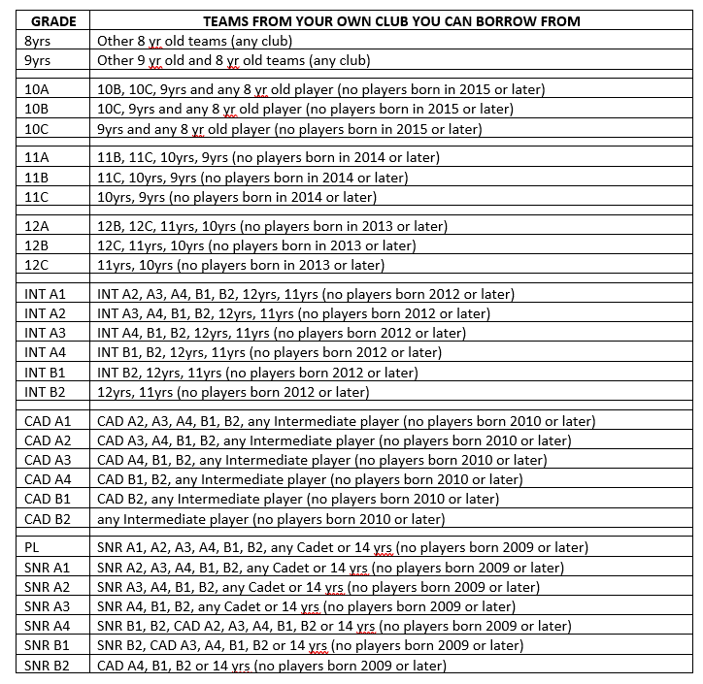
Borrowing Table

Slide 16
Competition Draw
The competition draw has been generated on PlayHQ and will be published for everyone on Wednesday 20 April
We believe that this will be available through our website illawarranetball.com.au – but as with everything with the new system, I’m always open to the fact it may not work as initially expected…
The courts have NOT been allocated for 4 June and beyond due to the uncertain nature of the courts, but will be completed once we have an update of how everything is progressing.

Slide 17
Club Duty Rosters
These will be made available to clubs this week.

